Slide 1
Interfacing Gsm module(sim900) with arduino
Presented By:
Ajay kumar vattikonda (C0763572)
group1

Slide 2
contents
Gsm sim900
Features of gsm moduleArduino uno
Arduino uno
Mode of communication used
Connections
Code
References

Slide 3
About Gsm module
SIM900 GSM/GPRS shield is a GSM modem, which can be integrated into a great number of IoT projects.
You can use this shield to accomplish almost anything a normal cell phone can; SMS text messages.
Make or receive phone calls, connecting to internet through GPRS, TCP/IP, and more.
To top it off, the shield supports quad-band GSM/GPRS network, meaning it works pretty much anywhere in the world.

Slide 4
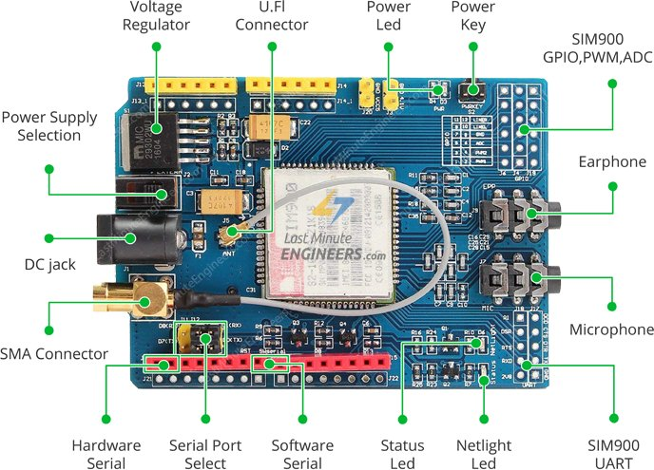
Gsm module working

Slide 5
Gsm module working
There are three LEDs on the SIM900 GSM/GPRS shield which indicates connectivity or power status.
By seeing these LEDs one can get a visual feedback on whats going on with the shield.
PWR: This LED is connected to the shield’s power supply line. If this LED is on, the shield is receiving power.
Status: This LED indicates SIM900’s working status. If this LED is on, the chip is in working mode.
Netlight: This LED indicates the status of your cellular network. It’ll blink at various rates to show what state it’s in.
off: The SIM900 chip is not running
64ms on, 800ms off: The SIM900 chip is running but not registered to the cellular network yet.
64ms on, 3 seconds off: The SIM900 chip is registered to the cellular network & can send/receive voice and SMS.
64ms on, 300ms off: The GPRS data connection you requested is active.

Slide 6
Gsm module power supply voltage
One of the most important parts of getting the SIM900 shield working is supplying it with enough power.
Recommended to use 5v,2A power adapter
Depending on which state it’s in, the SIM900 can be a relatively power-consuming device.
The maximum current draw of the chip is around 2A during transmission burst.
It usually won’t draw that much,but may require around 216mA during phone calls or 80mA during network transmissions.

Slide 7
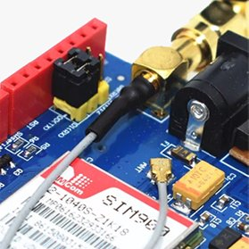
Gsm module Antenna
An antenna is required to use the SIM900 for any kind of voice or data communications as well as some SIM commands.
The shield has two interfaces for connecting antenna viz. a U.FL connector and a SMA connector. They are connected through a patch cord.

Slide 8
Gsm module features
The SIM900 shield packs with a lot of features ,Some of them are listed below:
Supports Quad-band: GSM850, EGSM900, DCS1800 and PCS1900
Connect onto any global GSM network with any 2G SIM
Make and receive voice calls using an external earphone & electret microphone
Send and receive SMS messages

Slide 9
Gsm module features
Send and receive GPRS data (TCP/IP, HTTP, etc.)
Scan and receive FM radio broadcasts
Transmit Power:
Class 4 (2W) for GSM850
Class 1 (1W) for DCS1800
Serial-based AT Command Set
U.FL and SMA connectors for cell antenna
Accepts Full-size SIM Card

Slide 10
Arduino uno
The microcontroller board used to interface with the gsm module in our project
Arduino Uno is an open-source microcontroller board based on the Microchip ATmega328P microcontroller and developed by Arduino.cc.
The board is equipped with sets of digital and analog input/output(I/O) pins that may be interfaced to various expansion boards (shields) and other circuits.
The board has 14 digital I/O pins (six capable of PWM (output), 6 analog I/O pins, and is programmable with the Arduino IDE (Integrated Development Environment), via a type B USB cable.

Slide 11
Arduino uno
It can be powered by the USB cable or by an external 9-volt battery, though it accepts voltages between 7 and 20 volts.
The board has 14 digital I/O pins (six capable of PWM (output), 6 analog I/O pins, and is programmable with the Arduino IDE (Integrated Development Environment), via a type B USB cable.
It can be powered by the USB cable or by an external 9-volt battery, though it accepts voltages between 7 and 20 volts.

Slide 12
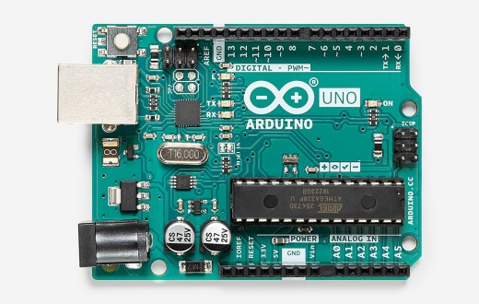
Arduino uno

Slide 13
Arduino uno technical specifications
Microcontroller | ATmega328P
Operating Voltage | 5V
Input Voltage (recommended) | 7-12V
Input Voltage (limit) | 6-20V
Digital I/O Pins | 14 (of which 6 provide PWM output)
PWM Digital I/O Pins | 6
Analog Input Pins | 6
DC Current per I/O Pin | 20 mA
DC Current for 3.3V Pin | 50 mA
Flash Memory | 32 KB (ATmega328P) of which 0.5 KB used by bootloader
SRAM | 2 KB (ATmega328P)
EEPROM | 1 KB (ATmega328P)
Clock Speed | 16 MHz
LED_BUILTIN | 13
Length | 68.6 mm
Width | 53.4 mm
Weight | 25 g

Slide 14
Arduino ide
The Arduino Integrated Development Environment - or Arduino Software (IDE) - contains a text editor for writing code, a message area, a text console, a toolbar with buttons for common functions and a series of menus.
Programs written using Arduino Software (IDE) are called sketches. These sketches are written in the text editor and are saved with the file extension .ino.

Slide 15
Arduino ide
The editor has features for cutting/pasting and for searching/replacing text.
The message area gives feedback while saving and exporting and also displays errors.
The console displays text output by the Arduino Software (IDE), including complete error messages and other information. The bottom righthand corner of the window displays the configured board and serial port.
The toolbar buttons allow you to verify and upload programs, create, open, and save sketches, and open the serial monitor.

Slide 16
Mode of communication used
The communication protocol used to interface gsm module and Arduino uno is UART.
A universal asynchronous receiver-transmitter is a compute hardware device for asynchronous serial communication in which the data format and transmission speeds are configurable. It sends data bits one by one, from the least significant to the most significant, framed by start and stop bits so that precise timing is handled by the communication channel.

Slide 17
connections
Arduino uno GSM Module
PIN 2 RX
PIN 3 TX
GND GND

Slide 18
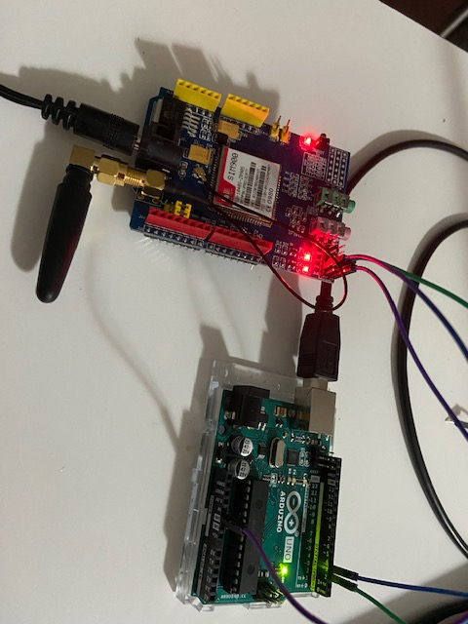
CONNECTIONS Picture

Slide 19
AT commands
For sending AT commands and communicating with the SIM900 shield.
It is the most basic AT command. It also initializes Auto-baud’er. If it works you should see the AT characters echo and then OK, telling you it’s OK and it’s understanding you correctly! You can then send some commands to query the shield and get information about it such as
AT+CSQ – Check the ‘signal strength’ – the first # is dB strength, it should be higher than around 5. Higher is better. Of course it depends on your antenna and location!

Slide 20
About AT commands
AT+CCID – get the SIM card number – this tests that the SIM card is found OK and you can verify the number is written on the card.
AT+CREG? Check that you’re registered on the network. The second # should be 1 or 5. 1 indicates you are registered to home network and 5 indicates roaming network. Other than these two numbers indicate you are not registered to any network.

Slide 21
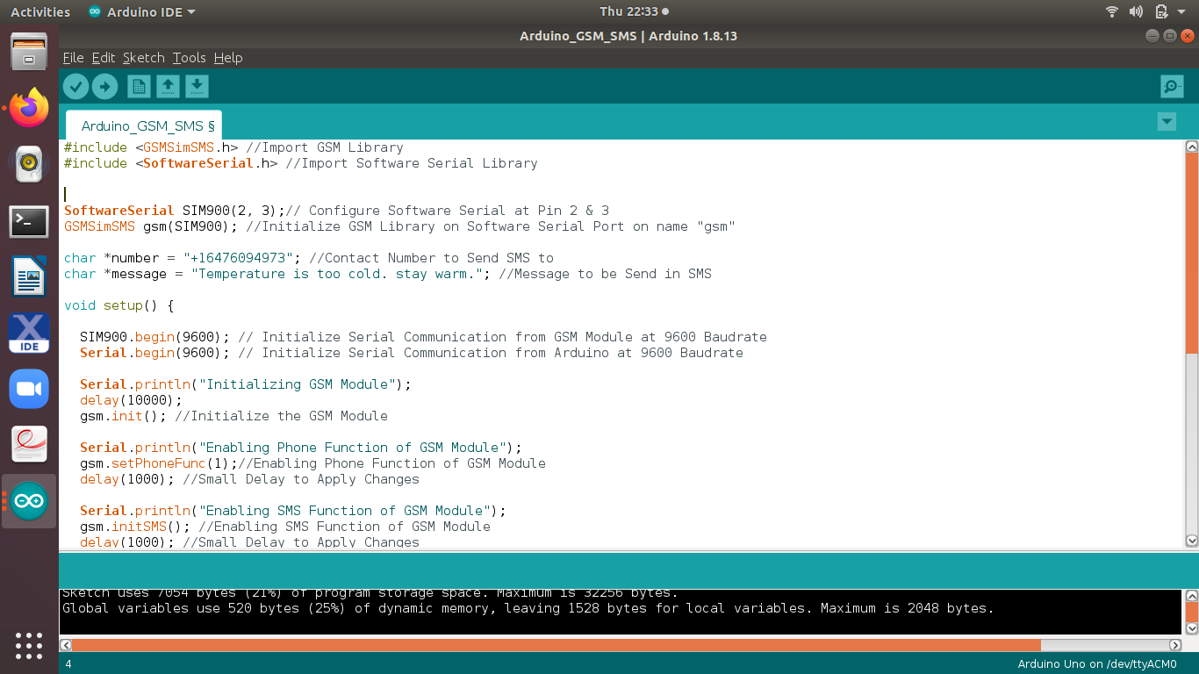
Arduno uno code

Slide 22
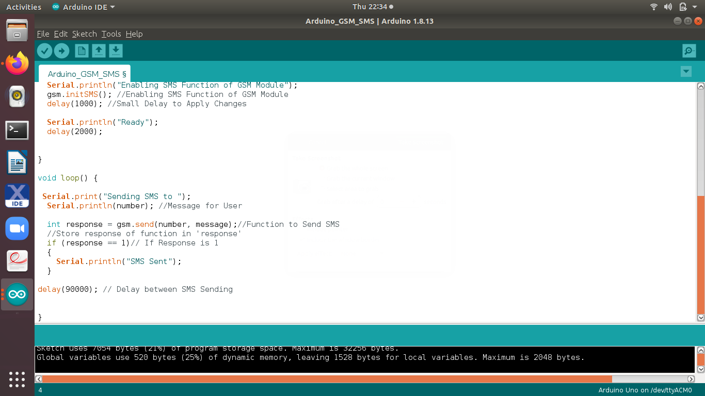
Arduino uno code

Slide 23
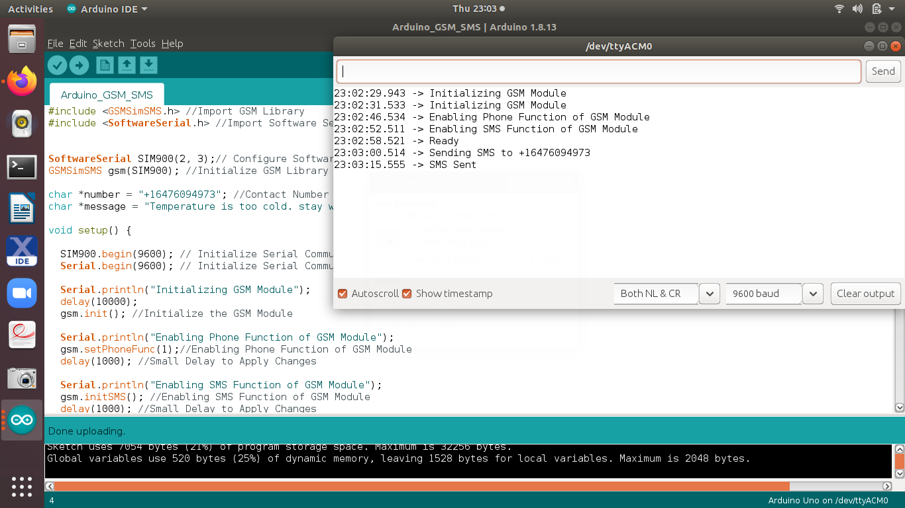
Output on the serial monitor

Slide 24
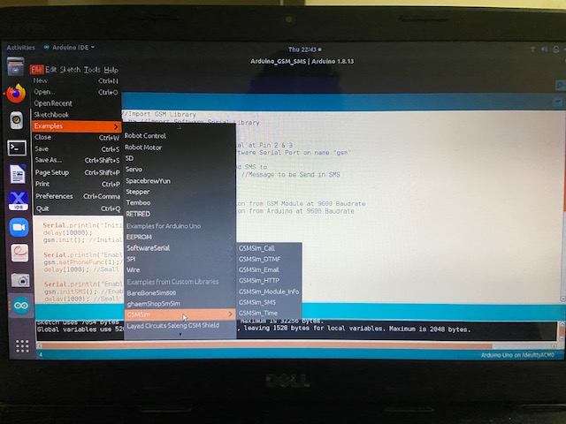
Arduino ide library used for gsm module

Slide 25
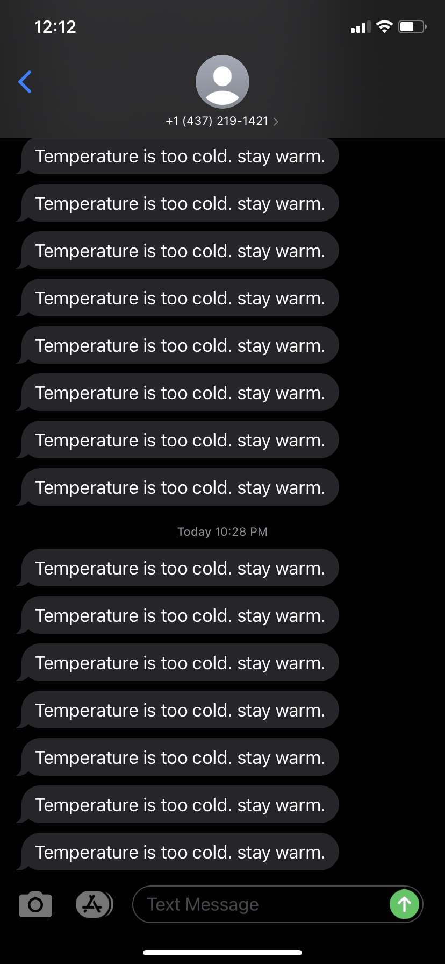
Text message sent to user

Slide 26
References
https://lastminuteengineers.com/sim900-gsm-shield-arduino-tutorial/
https://store.arduino.cc/usa/arduino-uno-rev3
https://en.wikipedia.org/wiki/Universal_asynchronous_receiver-transmitter#:

Slide 27
References
https://github.com/erdemarslan/GSMSim
https://github.com/erdemarslan/GSMSim/blob/master/examples/GSMSim_SMS/GSMSim_SMS.ino
https://elementztechblog.wordpress.com/2017/02/01/sim800-vs-sim900-what-is-the-differencesimilarities/

Slide 28
THANK YOU

